Slide 1
Textures
Graphics I Day 3

Slide 2
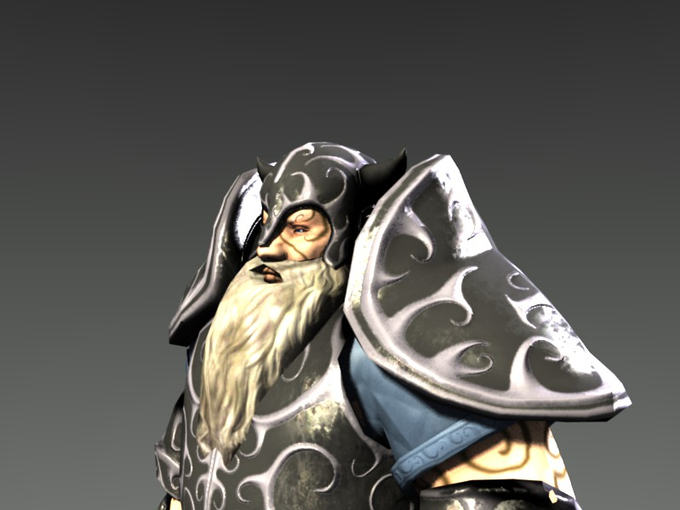
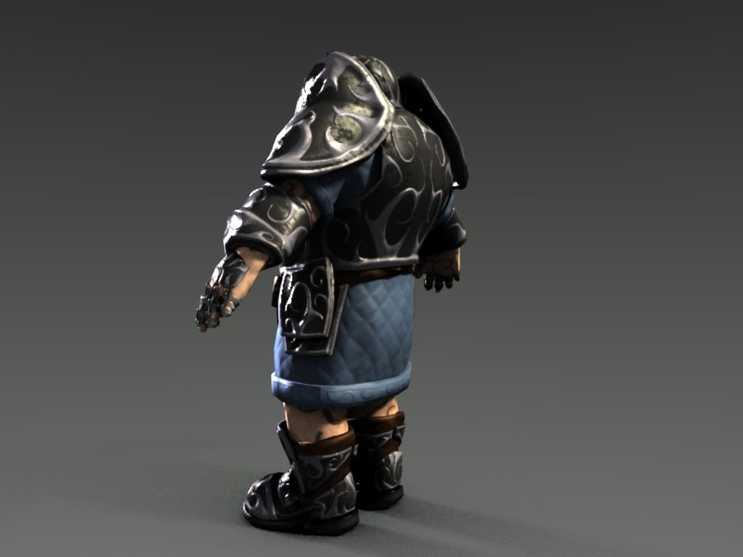
Modern Texturing: Beyond Color

Slide 3
Texturing: Applications.
Diffuse Maps:
Color data mapped across polygons. What people commonly think of when we refer to textures.
Specular Maps:
Lighting control map, controls the “shininess” of a surface.
Normal Maps:
Lighting control map, adds per-pixel normals to create the illusion of more detailed geometry.
Reflection / Environment Maps:
Used to help simulate highly reflective surfaces such as smooth metal, glass and certain plastics.
Also may be used to inexpensively represent distant scenery, typically called a “SkyBox”.

Slide 4
Texturing: Kinds of Textures
1D (ID3DTexture1D)
Gradient maps, Cell Shading, misc data storage.
1D Array (ID3DTexture1D)
An array of 1D textures that are all the same size and format.
2D (ID3DTexture2D)
Most common type, Diffuse maps, Specular maps, Normal maps, Detail maps, Blend Maps, etc…
2D Array (ID3DTexture2D)
An array of 2D textures that are all the same size and format.
3D (ID3DTexture3D)
Least common type, can be used for volumetric type effects and many other effects where 2D surface data is not enough.
CUBE* (ID3DTexture2D)
Comprised of 6 2D textures forming an inward facing cube. Common in most games, Reflection maps, Sky Boxes, Environment maps. Often sampled with a directional vector.
*Cube Maps are a specialized form of the 2D Array type.

Slide 5
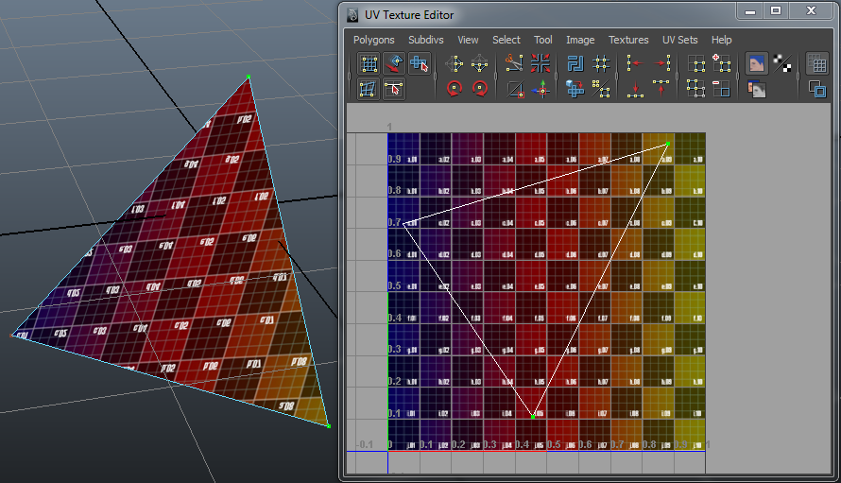
Texturing: UV Coordinates
Describes where a vertex falls within a texture.
By describing the three UV’s across a triangles surface we instruct our hardware how to display the image on the surface of the polygon.
UV data(Texture Space) is independent of the 3D Space.

Slide 6
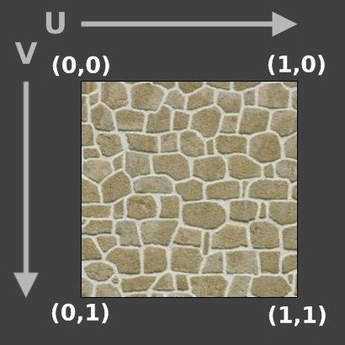
Texturing: D3D UV Space

Slide 7





Texturing: UV data beyond 0-1
(0,0)
(1,0)
(0,1)
(1,1)
WRAP
MIRROR
CLAMP
BORDER

Slide 8
The Pixel Shader Stage
This stage receives the output from the rasterizer stage.
Each rasterized pixel is operated on by the currently bound pixel shader.
The pixel shader determines the color that is actually sent to the Output Merger Stage.
From there the OM Stage determines if we discard, blend, or display a resulting pixel as is.
Because the pixel shader output is generally color data on the surface of a triangle, it is the most logical place to sample texture data. (At least as far as surface color is concerned)
Every programmable stage can access textures.

Slide 9
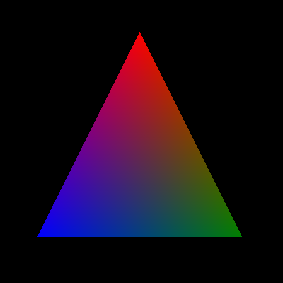
Pixel Shader: Interpolation
You may have noticed UV data is stored on a per-vertex basis. Three points on a texture do not seem like enough information to fill the interior of a triangle.
One key feature of the Pixel Shader Stage is the ability to receive “interpolated” data from the Rasterizer Stage.
Interpolation (in the case of triangles) is a weighted average of the data within the three vertices that make up the rasterized shape. This is how each pixel can receive data unique to itself.
0.4,0.9
1,0,0
0.4,0.15,0.7
0.32,0.301
0.1,0.3
0,0,1
0,1,0
0.9,0.1
COLORS
TEXCOORDS

Slide 10
Texturing: ID3D11SamplerState
Samplers are objects that allow us to exert a high degree of control over how texture data is retrieved.
They control the active addressing mode on each texture space axis: WRAP, CLAMP, MIRROR, etc..
They also control filtering behavior.
Texels(texture pixels) do not map 1:1 to pixels that are shown on screen.
In a 3D environment, if an object is far away or at an angle, you don’t need the maximum resolution of the texture.
The hardware can choose a lower resolution of the texture instead. This in known as Mip-Mapping.
As long as your texture has a Mip-Map pyramid this behavior is automatic.
Samplers allow you to choose one of many filter modes that determine how the various levels are combined.
The chosen behavior can have a major impact on visual quality.

Slide 11
ID3D11ShaderResourceView
A Shader Resource View(SRV) is required to bind certain resources like textures and particular types of buffers to the rendering pipeline.
An SRV allows a pipeline stage to READ data from a resource but not WRITE.
For example: to sample a texture in the pixel shader stage, you must first bind the corresponding SRV to the appropriate texture slot in the stage.

Slide 12
Sample Pixel Shader
texture2D baseTexture : register( t0 ); // first texture
texture2D detailTexture : register( t1 ); // second texture
SamplerState filters[2] : register( s0 ); // filter 0 using CLAMP, filter 1 using WRAP
// Pixel shader performing multi-texturing with a detail texture on a second UV channel
// A simple optimization would be to pack both UV sets into a single register
float4 main(float2 baseUV : TEXCOORD0, float2 detailUV : TEXCOORD1, float4 modulate : COLOR) : SV_TARGET
{
float4 baseColor = baseTexture.Sample( filters[0], baseUV ) * modulate; // get base color
float4 detailColor = detailTexture.Sample( filters[1], detailUV ); // get detail effect
float4 finalColor = float4(lerp(baseColor.rgb, detailColor.rgb, detailColor.a), baseColor.a);
return finalColor; // return a transition based on the detail alpha
}

Slide 13
FPS Style Flythrough Camera:
Step 1: Do you have a World Space Camera Matrix?.
Step 2: Motion
Get Input via: GetCursorPos() & GetAsyncKeystate()
Forwards & Backwards: Local Z Translation
Strafe Right & Left : Local X Translation
Fly Up & Down: Global Y Translation
Look Up & Down: Local X Rotation
Look Right & Left: Global Y Rotation
Step 3: Convert modified Camera Matrix to View Space by taking inverse.
Example Global Rotation:
Save matrix position
Place matrix at origin.(alter position only)
Multiply matrices in reverse order.
Finally restore original position.

Slide 14
Tips for Lab
For textures to look correct!
You’ll want camera movement to be sure of this.
Textures will look grainy when camera moves!
Proper texture memory including mip maps must be loaded.
The initial data is in the form of an array.
Your sampler correctly describing how to use this memory.

